Slide 1
Machine Learning
Lecture 4: More optimization for Linear Regression
Dr. Beilun Wang
Southeast University
School of Computer Science
and Engineering

Slide 2


Roadmap

Slide 3
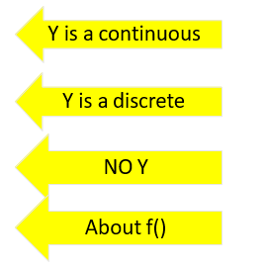
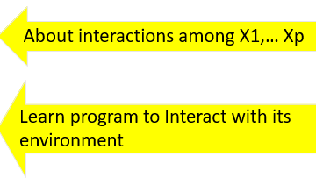
Course Content Plan
Six major sections of this course
❑ Regression (supervised)
❑ Classification (supervised)
❑ Unsupervised models
❑ Learning theory
❑ Graphical models
Reinforcement Learning

Slide 4
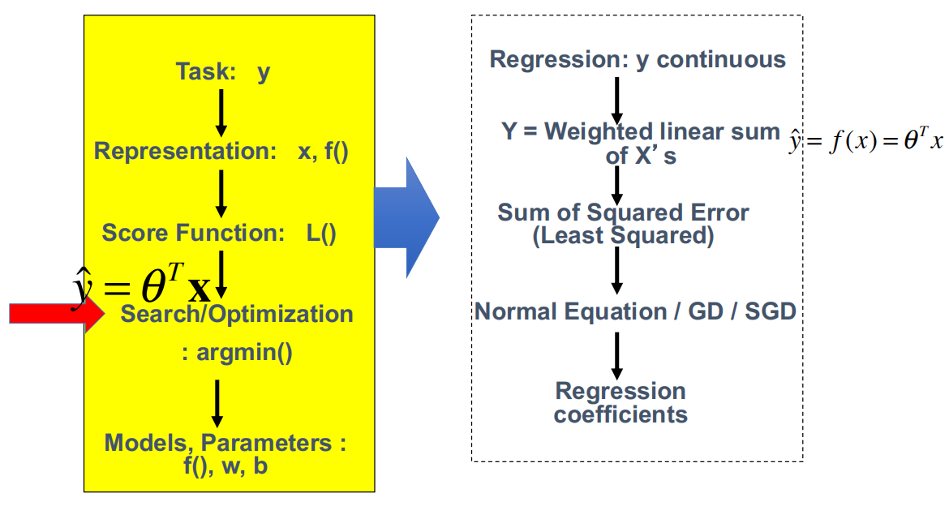
Today: Multivariate Linear Regression in a Nutshell

Slide 5
Today
More ways to train / perform optimization for linear regression models
Review: Gradient Descent
Gradient Descent (GD) for LR
Stochastic GD (SGD) for LR

Slide 6
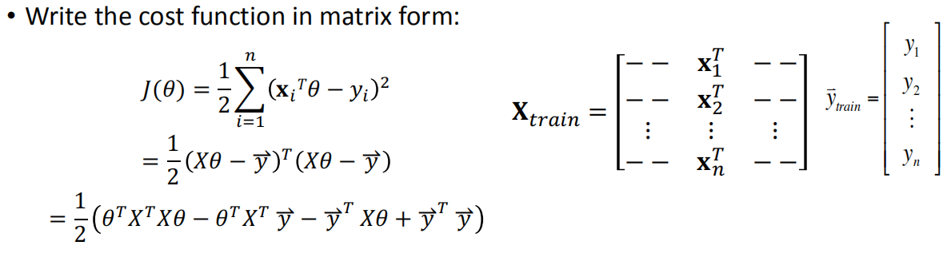
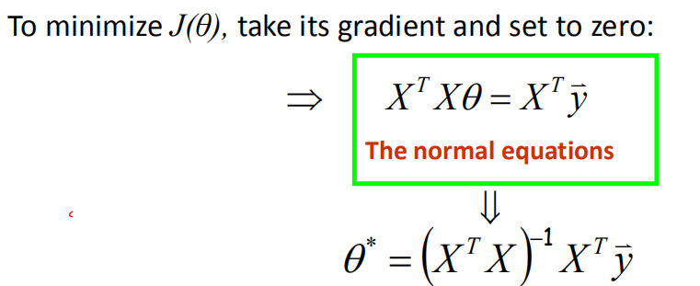
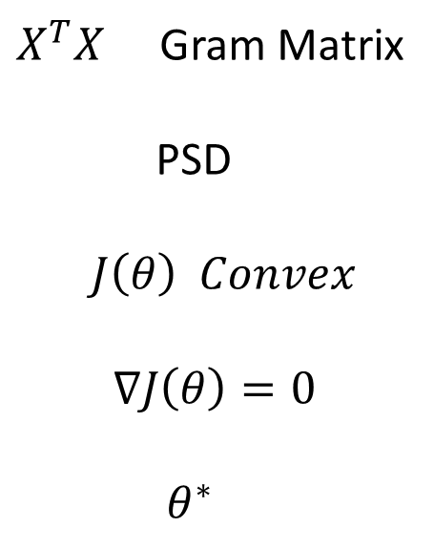
Method I: normal equations
$X^{T}X$ Gram Matrix
PSD
$J\left(θ\right) Convex$
$∇J\left(θ\right)=0$
$θ^{∗}$

Slide 7
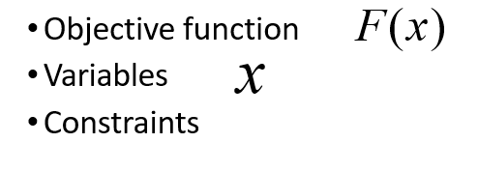
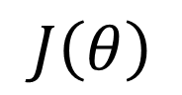
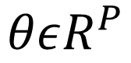
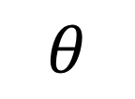
A little bit more about [ Optimization ]
$$J\left(θ\right)$$
$$θ$$
$$θεR^{P}$$
To find values of the variables
that minimize or maximize the objective function while satisfying the constraints

Slide 8
Today
More ways to train / perform optimization for linear regression models
Review: Gradient Descent
Gradient Descent (GD) for LR
Stochastic GD (SGD) for LR

Slide 9
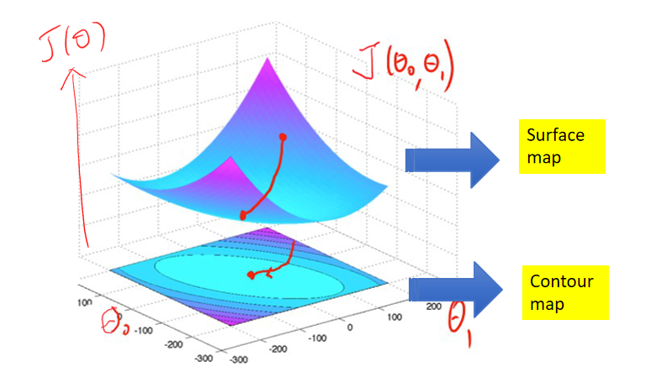
Review: two ways of Illustrating an Objective Function (e.g. 2D case)
Gradient vector points to the direction of greatest rate of increase of the objective function and its magnitude is the slope of the surface graph in that direction..

Slide 10
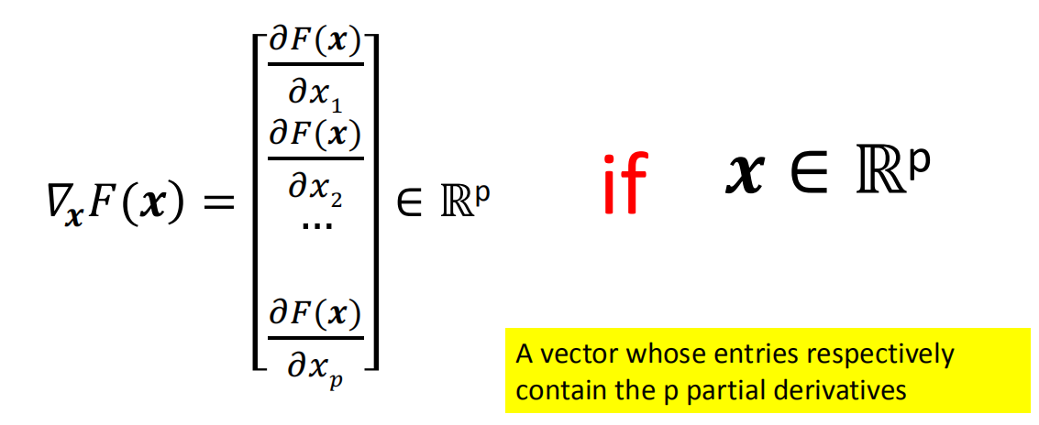
Review: Definitions of gradient (in L2-note)
Size of gradient vector is always the same as the size of the variable vector

Slide 11
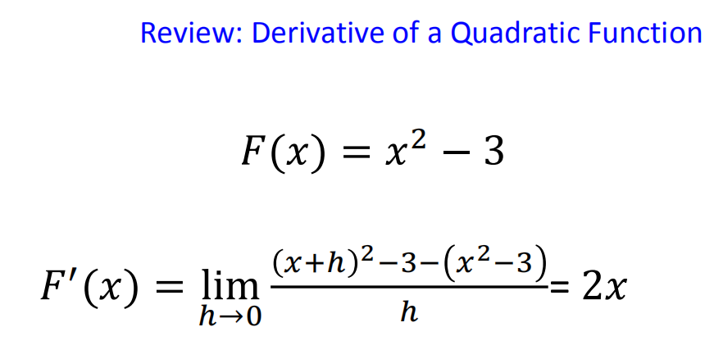
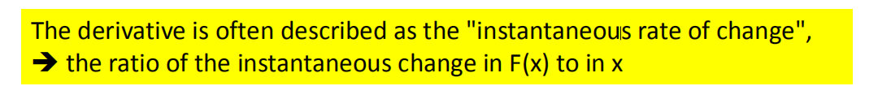

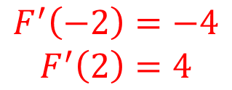
Review: Definitions of derivative (1D case)
6
5
4
3
2
1
$$change of F(X)$$
-3 -2 -1
0
-1
-2
-3
1 _{x} 2 3
$$F^{′}\left(−2\right)=−4$$
$$F^{′}\left(2\right)=4$$

Slide 12
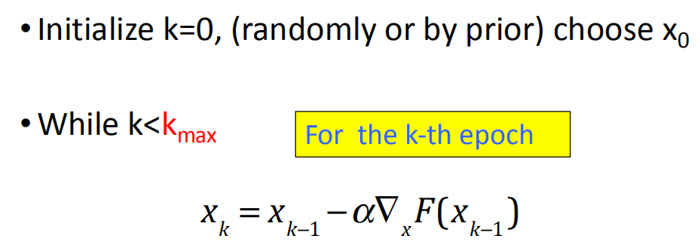
Gradient Descent (GD): An iterative Algorithm

Slide 13
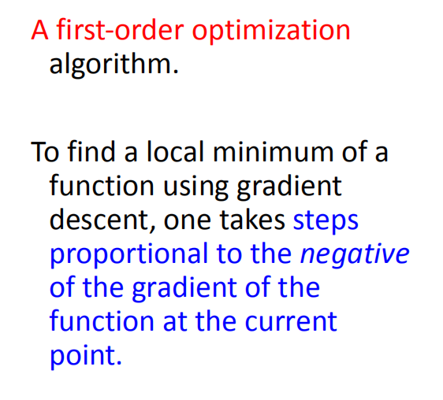
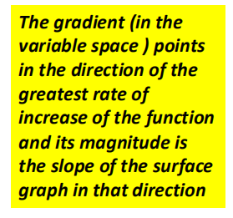
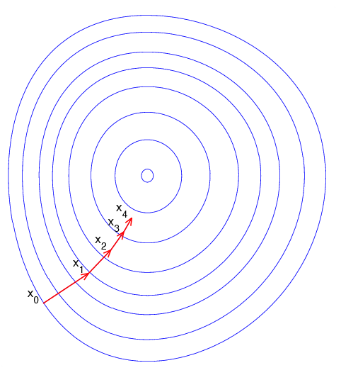

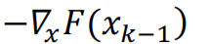

Gradient Descent ( Steepest Descent ) – contour map view
$$min$$

Slide 14
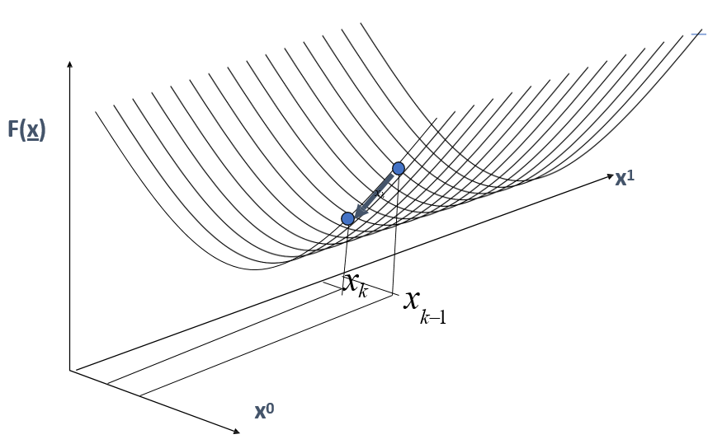
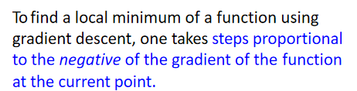
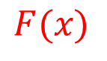

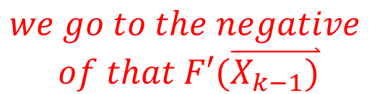
Illustration of Gradient Descent (2D case)
G$radient F′(\overset{⃑}{X_{k−1})}$ points to the direction
$$F(x)$$
$$we go to the negative$$
$$of that F′(\overset{⃑}{X_{k−1})}$$
Surface
Map view

Slide 15
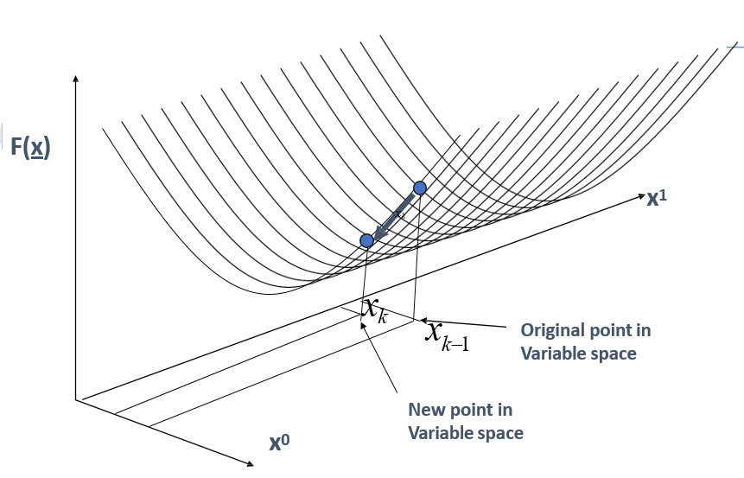
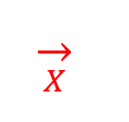
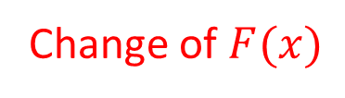
Illustration of Gradient Descent (2D case)
Change of $F(x)$
Change of
$$\overset{→}{X}$$
Surface
map view

Slide 16




Optimize through Gradient Descent (iterative) Algorithms
Works on any objective function f(x)
as long as we can evaluate the gradient
this can be very useful for minimizing complex functions

Slide 17
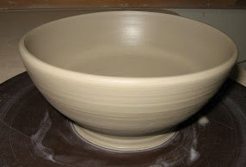
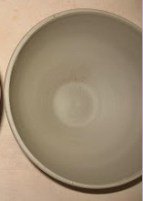



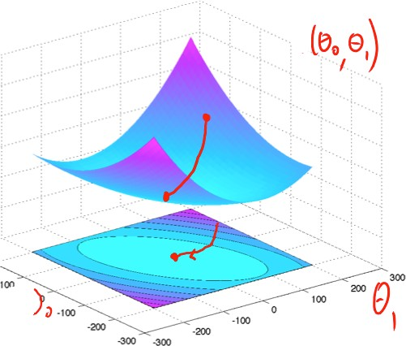

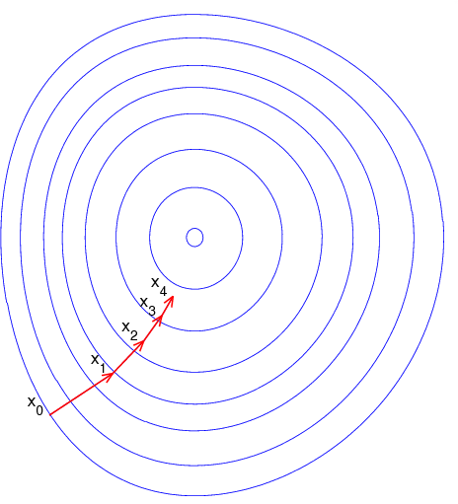


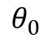
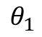
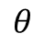
Surface map view
Contour map view
$$θ_{1}$$
$$θ$$
$$θ_{0}$$

Slide 18
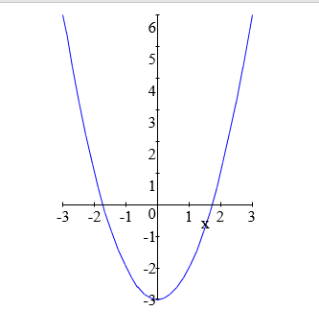
Review: Derivative of a Quadratic Function
F (x) = x² − 3
∇_{x} F (x) = F '(x) = 2x
x_{k} = x_{k−1} − α∇_{x} F(x_{k−1} )

Slide 19
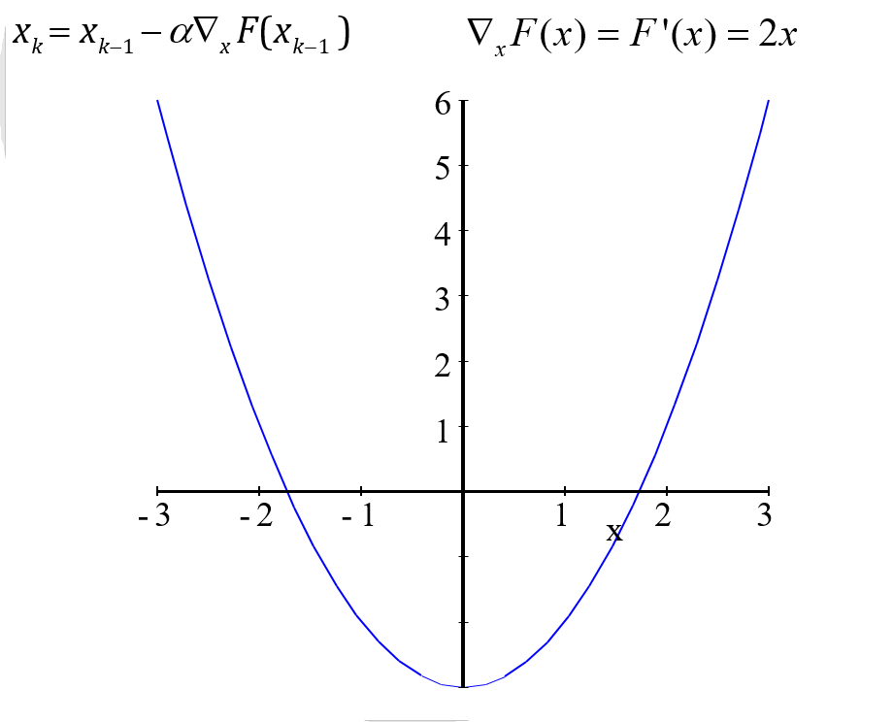

Slide 20
Gradient Descent (Iteratively Optimize)
Learning Rate Matters
Starting point matters
Objective function matters

Slide 21
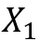
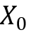
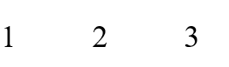
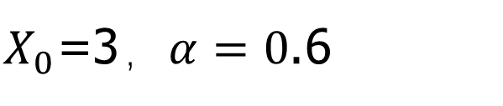
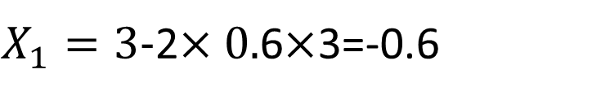
x_{k} = x_{k−1} − α∇_{x} F(x_{k−1} )
$X_{0}$=3，$α=0$.6
6
5
4
3
2
1
$X_{1}=3−$2$×0.$6$×$3=-0.6
-3 -2 -1

Slide 22

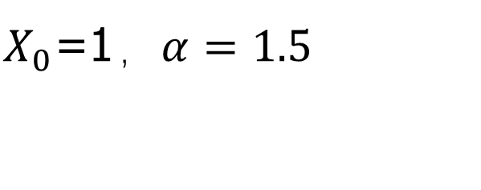
x_{k} = x_{k−1} − α∇_{x} F(x_{k−1} )
$X_{0}$=1，$α=1.5$
6
6
5
4
3
2
1
5
4
3
2
1
$$X_{1}=−2$$
$F\left(X_{1}\right)>F(X_{0})$!!!
-3 -2 -1

Slide 23
Gradient Descent (Iteratively Optimize)
Learning Rate Matters
Starting point matters
Objective function matters

Slide 24
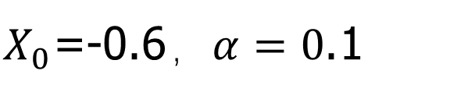
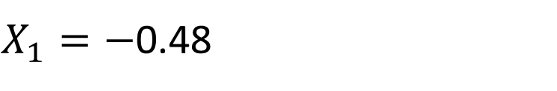
x_{k} = x_{k−1} − α∇_{x} F(x_{k−1} )
$X_{0}$=-0.6，$α=0$.1
6
5
4
3
2
1
$X_{1}=−$0.48
-3 -2 -1

Slide 25
Gradient Descent (Iteratively Optimize)
Learning Rate Matters
Starting point matters
Objective function matters

Slide 26
x_{k} = x_{k−1} − α∇_{x} F(x_{k−1} )
6
5
4
3
2
1
-3 -2 -1

Slide 27
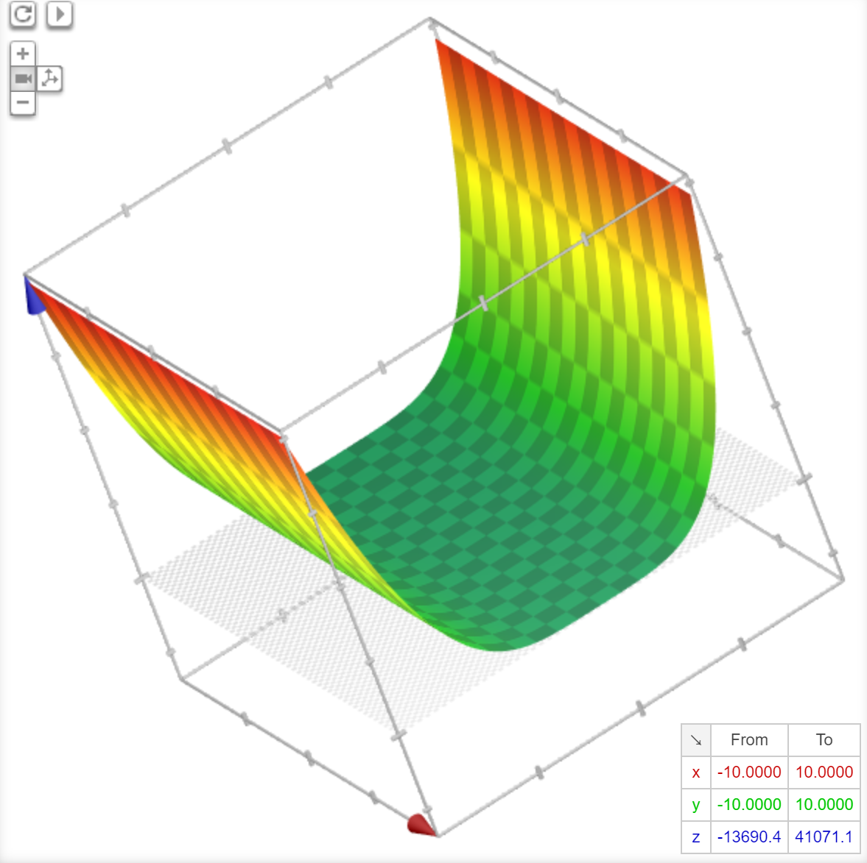
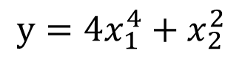
$$y=4x_{1}^{4}+x_{2}^{2}$$

Slide 28
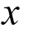

F (x)
Good side
small$α$ helps to stay in good side
Bad side
easy to stuck slowly in bad side

Slide 29

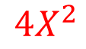
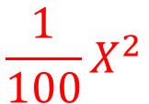
F (x)
Good side
GD fast side
$$\frac{1}{100}X^{2}$$
$$4X^{2}$$
Bad side
GD very slow
During optimization, We don’t want to jump from the good side to the bad side

Slide 30

Comments on Gradient Descent Algorithm
Works on any objective function F(x)
as long as we can evaluate the gradient
this can be very useful for minimizing complex functions
Local minima
Can have multiple local minima
(note: for LR, its cost function only has a single global minimum, so this is not a problem)
If gradient descent goes to the closest local minimum:
solution: random restarts from multiple places in weight space

Slide 31
Today
More ways to train / perform optimization for linear regression models
Review: Gradient Descent
Gradient Descent (GD) for LR
Stochastic GD (SGD) for LR

Slide 32
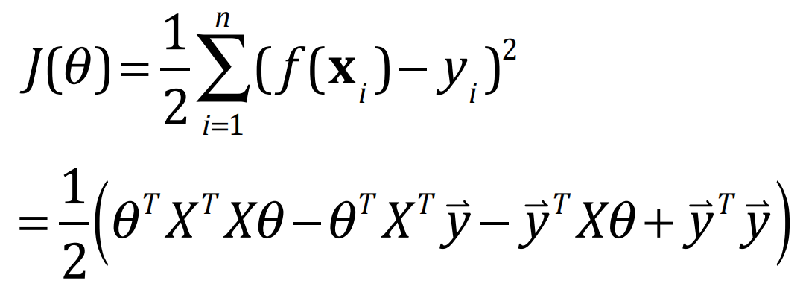
Review: Loss function of Least Square LR

Slide 33




Slide 34




Slide 35



LR with batch GD
A Batch gradient descent algorithm:
GD : x = x
− α∇ F(x )
k
k−1
x
k−1

Slide 36


Slide 37

Choosing the Right Step-Size / Learning-Rate

Slide 38
Today
More ways to train / perform optimization for linear regression models
Review: Gradient Descent
Gradient Descent (GD) for LR
Stochastic GD (SGD) for LR

Slide 39



LR with batch GD
$\frac{∂J(θ)}{∂θ}$=$\sum_{i=1}^{n}{(x_{i}^{T}θ}−y_{i})\overset{⃑}{x_{i}}$
The Cost Function:
Consider a gradient descent algorithm and reformulate:

Slide 40


LR with Stochastic GD ➔
Batch GD rule:
For a single training point (i-th), we have:
A "stochastic” descent algorithm, can be used as an on-line algorithm

Slide 41



$$derivation:∇J\left(θ\right)=$$
=$\sum_{i=1}^{n}{x_{i}(x_{i}^{T}θ}−y_{i})$

Slide 42


Stochastic gradient descent: Online Learning Algorithm
SGD
GD
versus

Slide 43


Stochastic gradient descent: More variations
Single-sample:
Mini-batch:
$θ^{t+1}$=$θ^{t}$+$α(y_{i}$-${\overset{⃑}{x_{i}}}^{T}θ^{t})\overset{⃑}{x_{i}}$

Slide 44
Mini-batch: (stochastic gradient descent)
Motivation: datasets are often highly redundant.
Compute the gradient on a small mini-batch of samples (e.g. B=32/64/)
Much faster computationally
Epoch/cover all examples
GD: one update
SGD: n-tr updates
minSGD: n-tr/B updates

Slide 45
(Stochastic) Gradient Descent (Iteratively Optimize)
Learning Rate Matters
Starting point matters
Objective function matters
Stop criterion matters!

Slide 46

Men- training loss
One good plot for GD/SGD
Epoch
Each pass of SGD repeated cycling through all samples in the whole train➔ an epoch !

Slide 47

Train MSE Error to observe:
In many situations, visualizing Train-MSE can be helpful to understand the behavior of your method, e.g., the influence of the hyper parameter you chose; e.g., how it decreases with epochs, …
In Homework, when we ask for plots of training error, we ask for the MSE per-sample train errors; Because it is comparable to test MSE error (later to cover).

Slide 48
When to stop (S)GD ?
Lots of stopping rules in the literature,
There are advantages and disadvantages to each, depending on context
E.g., a predetermined maximum number of iterations
E.g., stop when the improvement drops below a threshold
….

Slide 49

Today: Multivariate Linear Regression in a Nutshell
Task: y Representation: x, f()
Score Function: L() Search/Optimization
: argmin()
Models, Parameters :
Regression: y continuous
Y = Weighted linear sum of X’s
Sum of Squared Error (Least Squared)
Normal Equation / GD / SGD
Regression coefficients
yˆ = f (x) = θ ^{T} x

Slide 50
We aim to make the learned model
1. Generalize Well
2. Computational Scalable and Efficient
3. Robust / Trustworthy / Interpretable
Especially for some domains, this is about trust!

Slide 51
Stochastic gradient descent (1)
Useful when training with massive datasets
Useful when training data arrives online
SGD (offline training), by repeated cycling through the whole data
Each such pass over the whole data ➔ an epoch !
better to use mini-batch SGD (offline case)
B=1 standard SGD
B=N standard batch GD
E.g. B=50

Slide 52
Stochastic gradient descent (2)
Efficiency: Good approximation of Gradient:
Intuitively fairly good estimation of the gradient by looking at just a few examples
Carefully evaluating precise gradient using large set of examples is often a waste of time (because need to calculate the gradient of the next t any way)
Better to get a noisy estimate and move rapidly in the parameter space
SGD is often less prone to stuck in shallow local minima
Because of the certain “noise”,
popular for nonconvex optimization cases

Slide 53


Slide 54


Slide 55

1 | 1＜B＜n | n
SGD | miniB-SGD | GD
Very noisy GD update | A bit noisy GD update | GD update
Low memory cost | Middle memory cost | High memory cost
0 (one gradient cal cost) | If multi-parallel B threads 0 (one gradient cal cost) | Very costly gradient calculation

Slide 56


Summary so far: Four ways to learn LR
Normal equations
Pros: a single-shot algorithm! Easiest to implement.
Cons: need to compute pseudo-inverse (X^{T}X)⁻¹, expensive, numerical issues (e.g., matrix is singular ..), although there are ways to get around this …
GD
Pros: easy to implement, conceptually clean, guaranteed convergence
Cons: batch, often slow converging

Slide 57

Stochastic GD and miniB
Pros: on-line, low per-step cost, fast convergence and perhaps less prone to local optimum
Cons: convergence to optimum not always guaranteed

Slide 58




Computational Cost (Naïve Way)
pxn nxp
$$X^{T}X: O\left(p^{2}n\right)$$
$$O\left(p^{2}n+p^{3}\right)$$
$${(X^{T}X)}^{−1}: O(p^{3})$$
When n>>p, matrix’s multiplication is slower than inversion

Slide 59



Extra: Computational Cost (Naïve..)
mostly about Memory Cost →
Interesting discussion in: https://stackoverflow.com/que stions/10326853/why-does-lm- run-out-of-memory-while- matrix-multiplication-works- fine-for-coeffic
pxn nxp
$$X^{T}X: O\left(p^{2}n\right)$$
$${(X^{T}X)}^{−1}: O(p^{3})$$
$$O\left(p^{2}n+p^{3}\right)$$
When n>>p, matrix’s multiplication is slower than inversion

Slide 60


px1 px1 1x1 pxn nx1 nxp px1
nx1
nx1
px1
px1

Slide 61


Extra: Convergence rate
Theorem: the steepest descent / GD equation algorithm converge to the minimum of the cost characterized by normal equation:
If the learning rate parameter satisfy ➔
A formal analysis of GD-LR need more math; in practice, one can use a small α, or gradually decrease α.

Slide 62


LR with batch GD / Per Feature View
Note that:
For its j-th variable:
n
θ = θ + α
∑
( y − x θ )x
t +1
t
T t
i i
i
i=1
n
t +1
t
∑
T t
Update Rule Per Feature (Variable-Wise)
θ _{j} = θ _{j} + α
( y − x θ )x
i i
i , j
i=1

Slide 63


LR with Stochastic GD / Per Feature View
For a single training point (i-th), we have:
For its j-th variable:
Update Rule Per Feature (Variable-Wise)

Slide 64
Extra: Direct (normal equation) vs.
Iterative (GD, SGD,) methods
Direct methods: we can achieve the solution in a single step by solving the normal equation
Using Gaussian elimination or QR decomposition, we converge in a finite number of steps
It can be infeasible when data are streaming in in real time, or of very large amount
Iterative methods: stochastic GD or GD
Converging in a limiting sense
But more attractive in large practical problems
Caution is needed for deciding the learning rate

Slide 65





One concrete example (Gaussian Elimination to solve)
Step ’A’:
Step ’B’:
Step ’C’:
Step ’D’:
In Step [D], we solve the matrix equation via Gaussian Elimination

Slide 66
Extra: Newton’s Method and
Connecting to
Normal Equation

Slide 67
Review: Single Var-Func to Multivariate
Single Var- Multivariate Calculus Function
Derivative Second-order derivative
Partial Derivative Gradient
Directional Partial Derivative Vector Field
Contour map of a function Surface map of a function
Hessian matrix
Jacobian matrix (vector in / vector out)

Slide 68
p=1 | c=1 | derivative | 2-nd order derivative
p>1 | c=1 | Gradient vector | Hessian matrix
p>1 | c>1 | Jacobian matrix

Slide 69

Review: Hessian Matrix / n==2 case
Singlevariate → multivariate
1st derivative to gradient,
#
2nd derivative to Hessian

Slide 70

Review: Hessian Matrix

Slide 71

Review: Newton Method
Quadratic method to find equation solution
Problem: find the solution of $f\left(x\right)=0$
$x_{k}=x_{k−1}−\frac{f(x_{k−1})}{f^{′}(x_{k−1})}$
Optimization equals to $∇f\left(x\right)=0$ (not always true)

Slide 72


Newton’s method for optimization
The most basic second-order optimization algorithm
Updating parameter with
GD: $θ_{k+1}=θ_{k}$ - $αg_{k}$
Newton：
pxp
px1
px1

Slide 73


Newton’s Method / second-order Taylor series approximation
θ_{k}
^{θ}k+1

Slide 74

Newton’s Method / second-order Taylor series approximation

Slide 75

Newton’s Method / second-order Taylor series approximation

Slide 76
Newton’s Method / second-order Taylor series approximation

Slide 77

Newton’s Method
At each step:
₋ f ″(θ_{k} )
θ = θ
k+1
k
f ″ (θ )
k
^{θ}k+1 ^{= θ}k
Requires 1st and 2nd derivatives
Quadratic convergence
− H ⁻¹(θ )∇f (θ )
k k
➔ However, finding the inverse of the Hessian matrix is often expensive

Slide 78

Comparison
Newton’s method vs. Gradient descent
A comparison of gradient descent (green) and Newton's method (red) for minimizing a function (with small step sizes).
Newton’s method uses curvature information to get a more direct route …
GD

Slide 79

Derivation:
???
Normal Equation?
Newton’s method for Linear Regression

Slide 80
References
https://qiyanjun.github.io/2019f-UVA-CS6316-MachineLearning/

Slide 81
Thanks for listening

